Slide 1
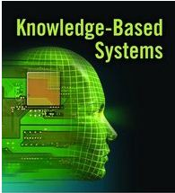
Lecture 2
CT-524
Knowledge Based System

Slide 2
Knowledge based system (Introduction)
The name Expert Systems was derived from the term knowledge-base expert systems.
An ES is a system that employs human knowledge captured in a computer to solve problems.

Slide 3
History of Knowledge-based Systems
The AI community developed Expert Systems as early as the mid 1960s. One attempt in
this direction was the General-purpose Problem Solver. Developed by Newell and Simon 1973

Slide 4
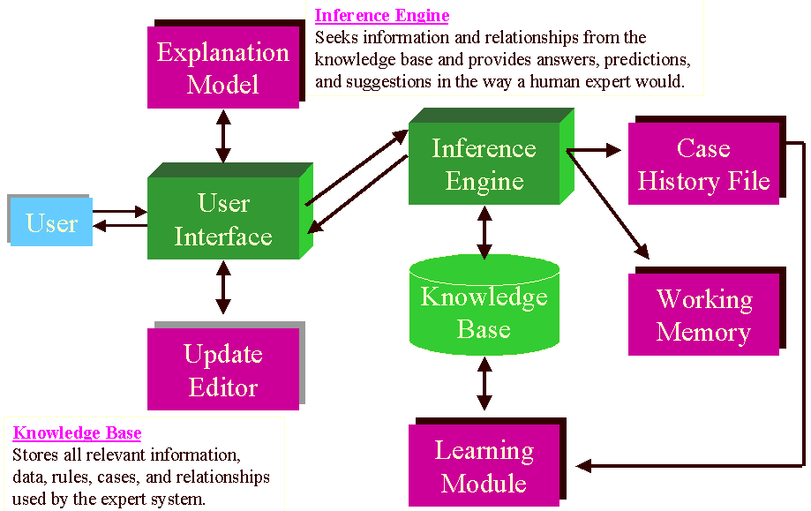
Architecture of Rule-based Expert Systems

Slide 5
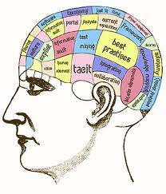
Knowledge ?

Slide 6
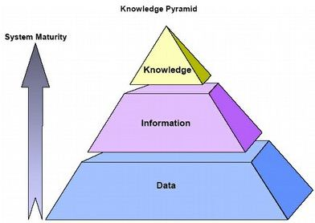
What is Knowledge ?
In the field of information system it is customary to distinguish between:
Data
The term Data refers to numeric (or alphanumeric) string that by them does not have a meaning. They can be facts and figures to be processed.
Information
Information a data organized so that it is meaning full to the person receiving it.
Knowledge
According to the Webster’s New Dictionary of the American Language, knowledge is:
· A clear and certain perception of something.
· Understanding
· Learning
· All that has been perceived or Grasped by the mind
· Practical experience skill
· Acquaintance or familiarity.
· Recognition,
· Organized information applicable to problem solving

Slide 7
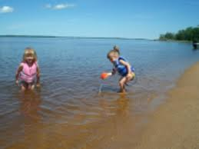

Level of Knowledge
Shallow Knowledge
Surface level knowledge use solve low-level problem can be expressed by IF THEN rule.
E.g., IF here is no fuel in the fuel tank THEN engine will not turn over.
Deep Knowledge
Human beings use deep level knowledge for solving complex problem. Like doctor
diagnose disease of patient. An automobile engineer determines the problem.

Slide 8
Deep Knowledge Investigation

Slide 9
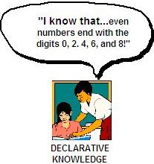
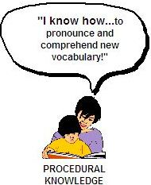
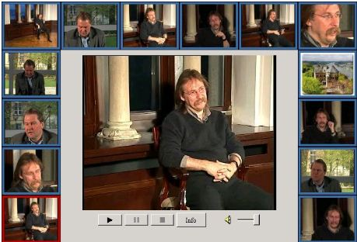
Categories of Knowledge
Declarative Knowledge
Declarative knowledge is a descriptive representation of knowledge.
It is expressed in a factual statement.
E.g. “There is positive association between smoking and cancer”.
Procedural Knowledge
Procedural knowledge step-by-step sequences and how-to types of
instructions
Heuristic Knowledge
Derived from the Greek word for “Discovery”. Depends on our experience, judgments,
tricks etc.
Meta Knowledge
Knowledge about knowledge

Slide 10
What types of knowledge might need representing?
Factual (declarative) knowledge
Facts about objects and concepts
The capital of Italy is Rome
Rome wasn’t built in a day
A day consists of 24 hours
20 and 4 make 24

Slide 11
Procedural knowledge
Describing how a problem is solved.
To make a vegetable stew, first slice some onions…
To get to Edinburgh from Brighton by train, first go to Brighton station…
To find the mean of three figures, add them and divide by three

Slide 12
Meta-knowledge
Knowledge about your/the system’s knowledge
Do you know the Queen’s phone number?
Do you know your best friend’s phone number?
Do you know who the prime minister is?
Do you know what “Weltanschauung” means?

Slide 13
Heuristic knowledge
Rules of thumb about some knowledge domain
For instance, in a medical expert system - if patient has spots, it’s probably chickenpox
In a mechanical trouble shooting system - if engine doesn’t turn over, check battery

Slide 14
What sorts of applications would need this knowledge?
Planning systems - e.g. walls support a house
(so usually shouldn’t plan to build roof first)
Expert problem solving systems - e.g. a baby’s pulse if normally faster than an adult’s
Natural Language Understanding Systems - e.g. the UK PM lives in Downing Street, so “an announcement from Downing St” is a government announcement

Slide 15
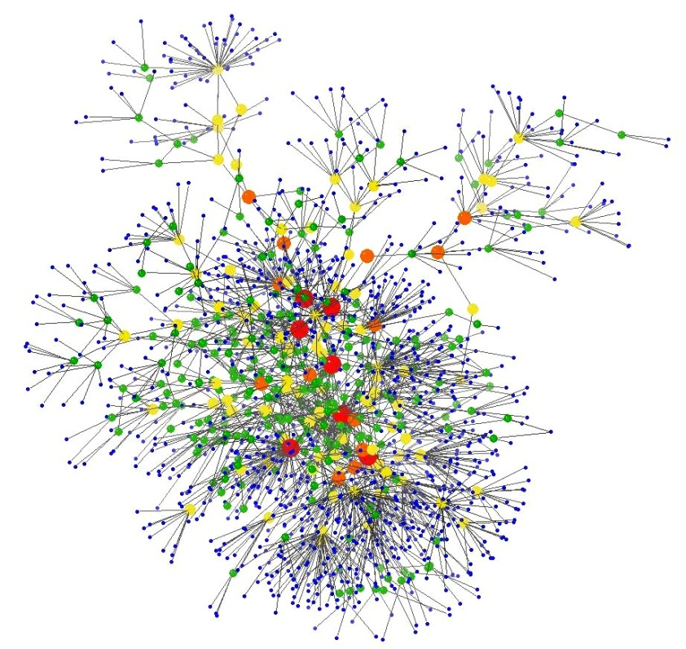
Knowledge Representation

Slide 16
What approaches have been put forward?
Propositional logic and predicate calculus
Production Rules
Semantic Networks
Frames
Conceptual Dependency
Scripts

Slide 17
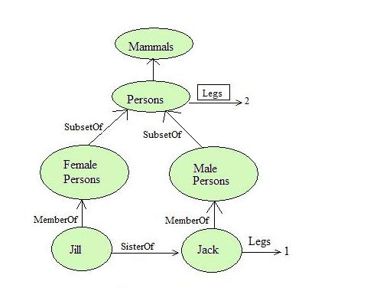
Semantic Networks
“A method of knowledge representation using a graph made up of nodes and arcs, where nodes usually represent objects, and arcs the relationships between objects”
A kind of “slot and filler” relationship relating attributes and values especially class membership (is_a or a_kind_of) and instance (is_instance).

Slide 18
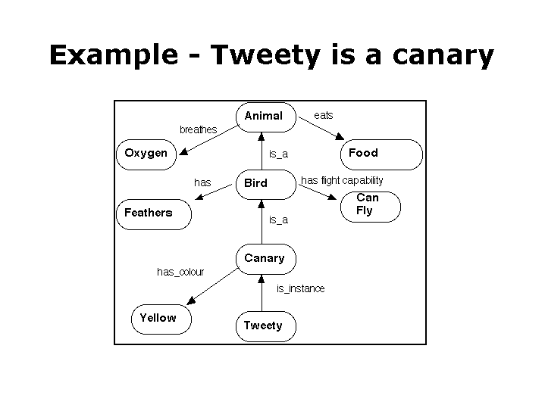

Slide 19
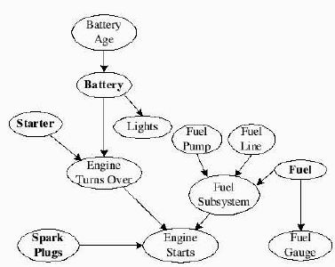
A Bayesian Network for an automobile troubleshooting program

Slide 20
“What colour is Tweety?”, “Can Tweety fly?”, “Does Tweety breathe air?”:
Value Inheritance Procedure
Let F be the given node and S the given slot or attribute
1.
Form a queue consisting of the node F and all the class nodes found in F's is_instance slot(s). Node F is to be in front.

Slide 21
Source of Knowledge
Knowledge may be collected from many sources.
Books, News papers, Computer, Databases
Films, Pictures
Maps, Flow diagram
Stories, Experiences
Observed behavior

